Slide 1
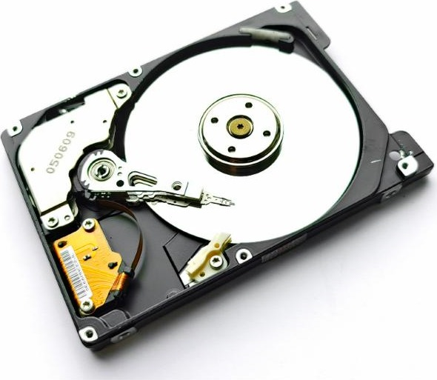
Hardware 2
Y12 - Cambridge International 9618 | 3.1
1
Notes:
Second lesson on 3.1. Covers the principal operation of a magnetic hard disk, solid state (flash) memory and an optical disc reader/writer, and the use of buffers. A shorter lesson: about 50 minutes of content.
Suggested pacing (also on slide 13):
0-5 recall starter (Task 1)
5-15 magnetic hard disk (slides 4-6) + Task 2
15-25 solid state, HDD vs SSD (slides 7-8) + Task 3
25-40 optical discs and buffers (slides 9-12) + Task 4
40-45 exit question.
Task 5 (real Paper 1 questions) is homework. Photo credits are on the last slide.

Slide 2
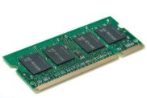
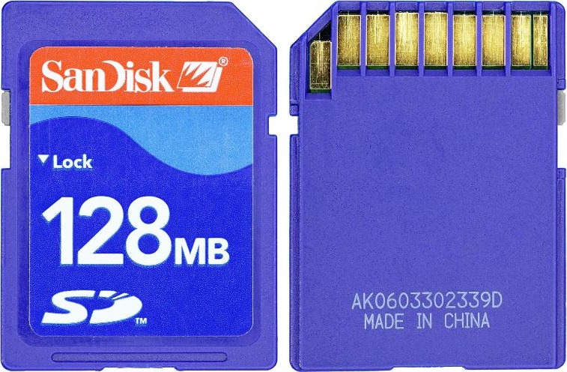
Starter: what do you remember?
Starter activity
1
RAM is volatile. What does volatile mean?
2
Which type of RAM is used for cache memory?
3
Give one difference between EPROM and EEPROM.
4
What does the ROM in a computer hold?
5
What is an embedded system?
2
Notes:
Worksheet Task 1 - retrieval from Hardware 1, 5 minutes. Answers: (1) volatile - contents lost without power; (2) SRAM; (3) EEPROM is erased electrically, in the circuit, byte by byte; EPROM needs UV light and must be removed; (4) the start-up (bootstrap) instructions / BIOS / firmware; (5) a processor, memory and I/O built into a larger device, dedicated to one task.

Slide 3
In this lesson, you will
Objectives
Describe how a magnetic hard disk reads and writes data
Describe how solid state (flash) memory stores data
Compare hard disks and solid state drives, and choose one for a task
Describe how an optical disc reader/writer works
Explain why buffers are used
3

Slide 4
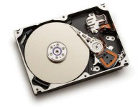
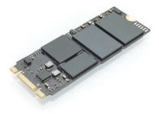
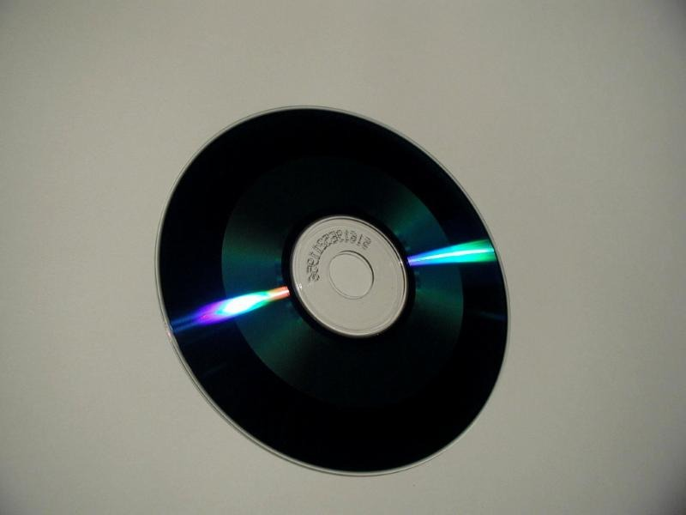
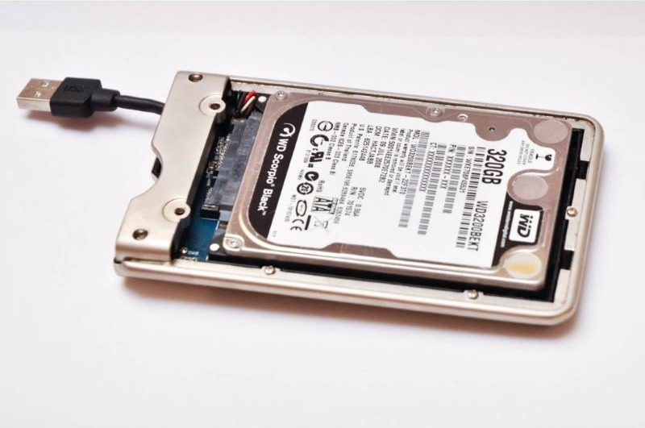
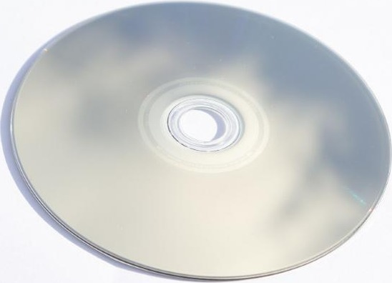
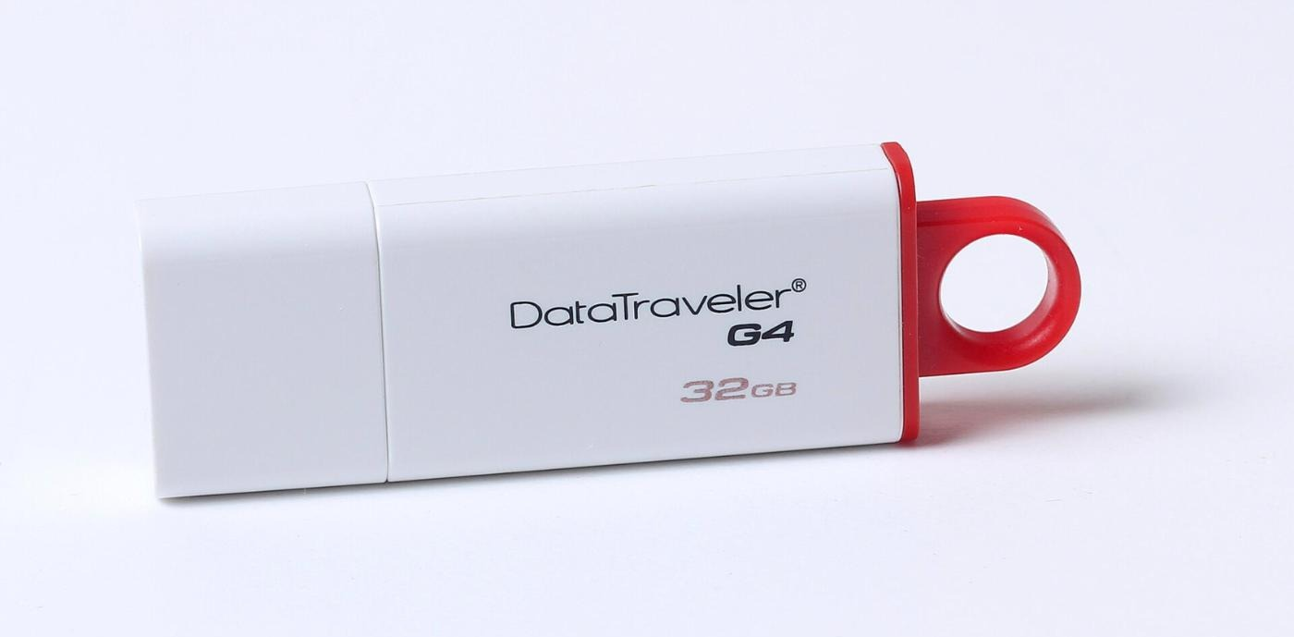
Three kinds of secondary storage
Activity 1
Magnetic
Solid state
Optical
Hard disk drive (HDD)
SSD, flash drive, memory card
CD, DVD, Blu-ray
Removable versions:
USB flash drive
External HDD
Optical disc
4
Notes:
Secondary storage is non-volatile and not directly accessed by the CPU (recap from Hardware 1). The three technologies: magnetic (hard disk drive), solid state (flash memory: SSD, USB flash drive, memory card) and optical (CD, DVD, Blu-ray). Any of them can be removable: an external hard disk in a USB case, a flash drive, a disc.

Slide 5
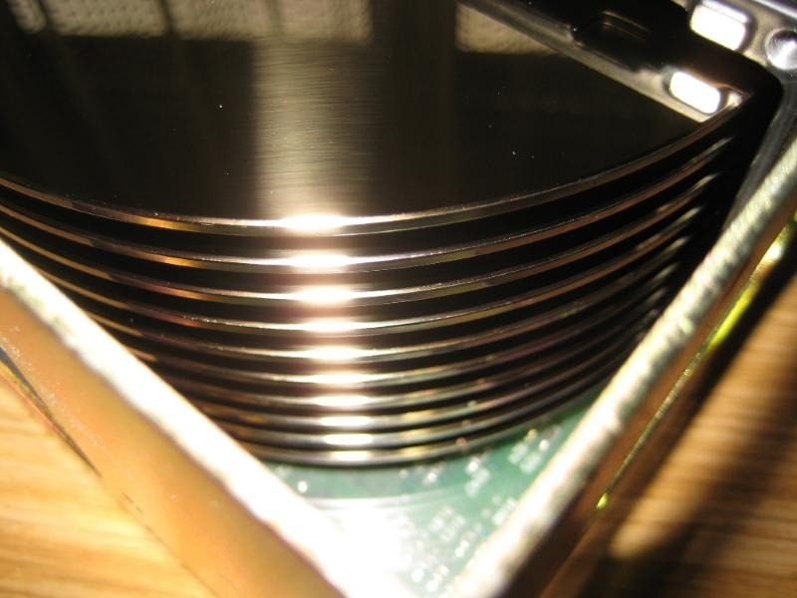
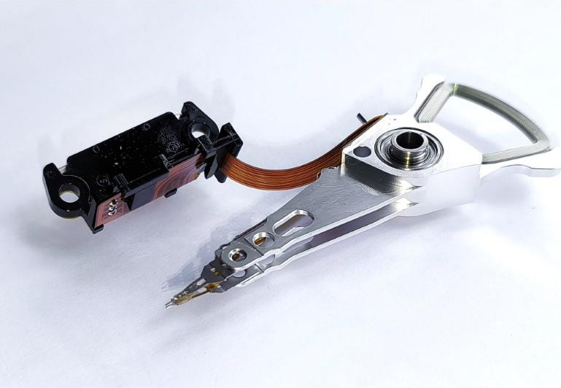
Inside a magnetic hard disk
Activity 2
platter
spindle
read/write head
A stack of platters
actuator arm
Arm with read/write heads
5
Notes:
Parts: one or more platters (aluminium or glass disks with a magnetic coating, both surfaces usable); a spindle that spins them at high speed (typically 5400-7200 rpm); a read/write head for each surface on an actuator arm that moves across the surface, floating a tiny distance above it. This is exactly the vocabulary in 9618/11 June 2025 Q6(a)(i) (Task 5).

Slide 6
How a hard disk reads and writes
Activity 2
tracks (rings) and sectors (slices)
1
Spin
The spindle spins the platters at high speed
2
Move
The arm moves the head to the correct track
3
Wait
The sector rotates under the head (latency)
4
Write
The head magnetises tiny areas: 1 or 0
5
Read
yellow: one sector on one track
Magnetic changes produce a change in the current in the head
6
Notes:
Principal operation: the platters spin on the spindle; the actuator arm moves the read/write head to the correct track; it waits for the correct sector to rotate under it (latency). Writing: current in the head creates a magnetic field that magnetises tiny areas of the surface in one of two directions (1 or 0). Reading: the magnetised areas passing under the head change the magnetic field, which produces a change in the electric current in the head - interpreted as 1s and 0s (mark scheme wording, 9618/11 J25). Data is stored in sectors on tracks; a file may be spread across non-adjacent sectors (fragmented), so the head has to move more and access slows down. Defragmentation rearranges the sectors. Worksheet Task 2 now.

Slide 7
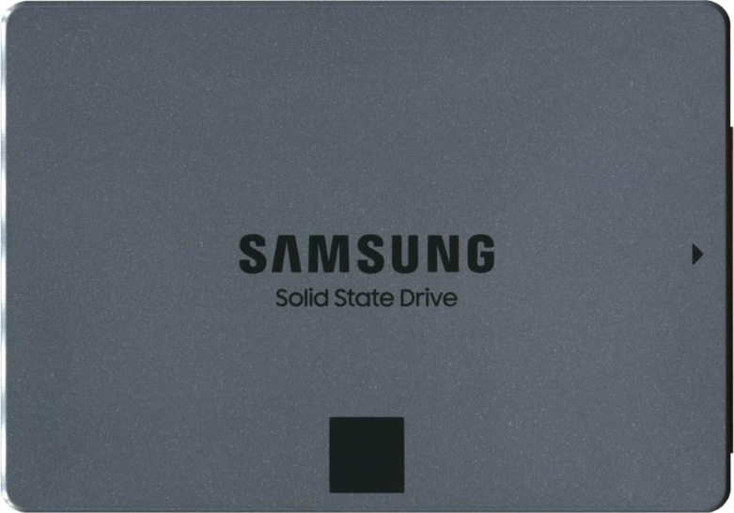
Solid state (flash) memory
Activity 3
Control gate
How it works
Each cell has two transistors: a floating gate and a control gate
Electrons trapped in the floating gate stay there without power: non-volatile
The control gate controls whether current flows - so the cell can be read
NAND flash is erased and written in blocks; no moving parts
insulating layer
Floating gate
insulating layer
Silicon
one flash memory cell (simplified)
Floating gate holds the charge. Control gate controls the current.
Flash drive
SSD
7
Notes:
Flash memory has no moving parts. It is built from NAND (or NOR) flash chips; each cell has two transistors - a floating gate and a control gate (textbook; mark scheme 9618/11 J24 Q2(c)(ii)). Electrons are trapped in the floating gate, which is surrounded by insulation, so the charge stays without power (non-volatile). The control gate controls whether current can flow, which is how the cell is written and read: trapped electrons = one value, none = the other. NAND flash (cheaper, most SSDs and USB drives) reads and erases in blocks; NOR / EEPROM can work a byte at a time. Data cannot be overwritten in place: the block is erased first, then written.

Slide 8
Hard disk or solid state?
Activity 3
 | Hard disk drive (magnetic) | Solid state drive (flash)
Moving parts | Yes - can wear or break if dropped | None - more reliable
Access speed | Slower: head movement + latency | Much faster, no latency
Power, heat, weight | More | Less - ideal for laptops
Cost per GB | Lower | Higher
Capacity | Very large | Usually smaller
Many write operations | Copes well (longevity) | Limited endurance
HDD
SSD
8
Notes:
From the textbook and mark schemes. SSD benefits: no moving parts so more reliable and robust; faster access with no latency; lighter, thinner, cooler and lower power - ideal for laptops and phones. HDD benefits: lower cost per GB; larger capacities; copes better with a very large number of write operations (SSD endurance is limited), so used for servers and systems that record all the time. 9618/11 J23 Q4(b) (Task 5) asks why magnetic is better for a CCTV computer storing video. Worksheet Task 3 now.

Slide 9
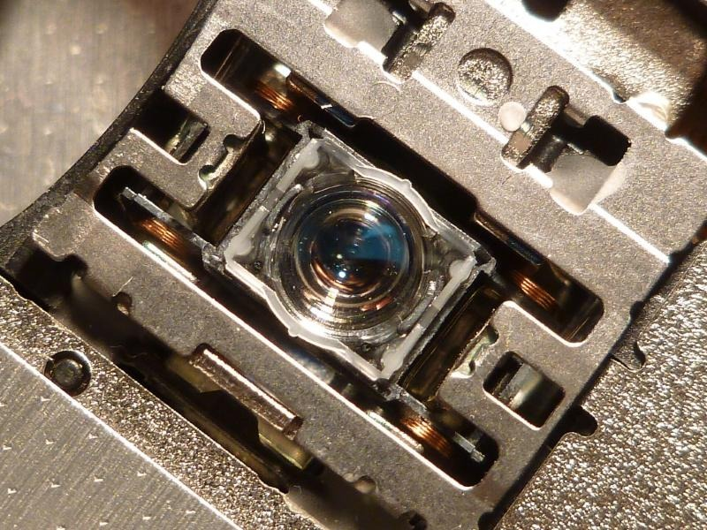
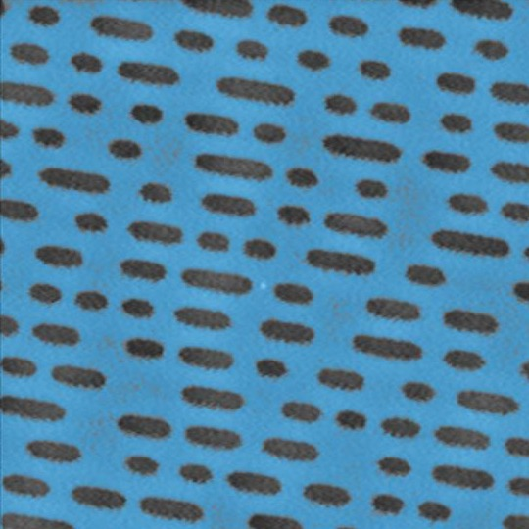
Optical disc reader/writer
Activity 4
one spiral track, centre outwards
1
Spin
The disc spins at high speed
2
Laser
The optical head moves the laser along the spiral track
3
Write
Lens of the laser
The laser burns pits into the surface
4
Read
Light reflects differently from pits and lands
5
Detect
The differences are read as 1s and 0s
Pits on a DVD (microscope)
9
Notes:
Principal operation (mark-scheme points, 9618/11 N24 Q3(d)(i)): the disc is spun at high speed; a laser is shone onto the disc to read or write, the optical head moving it into position; it follows a single spiral track from the centre outwards. Writing: the laser burns pits to represent the data (on a recordable disc it changes the dye layer). Reading: the laser reflects from pits and lands; the reflection from a pit and a land is different; a sensor detects the differences, which are interpreted as 1s and 0s. R discs can be written once; RW discs many times.

Slide 10

CD, DVD and Blu-ray
Activity 4
 | CD | DVD | Blu-ray
Laser colour | Red | Red | Blue
Wavelength | 780 nm | 650 nm | 405 nm
Construction | Single 1.2 mm layer | Two 0.6 mm layers | Single 1.1 mm layer
Track pitch | 1.60 µm | 0.74 µm | 0.30 µm
Typical capacity | 700 MB | 4.7 GB (8.5 GB dual layer) | 25 GB per layer
Optical disc
Shorter wavelength = smaller pits and closer tracks = more data.
Disc drive in a laptop
10
Notes:
Textbook Table 3.4. The shorter the laser wavelength, the smaller the pits and the closer the tracks, so the more data fits on a disc of the same size. DVD: two 0.6 mm layers (dual layer) - a red laser focuses on one or the other. Blu-ray: blue laser (405 nm), single 1.1 mm layer, so no birefringence (light split into two beams causing read errors); up to five times a DVD; built-in encryption against piracy.

Slide 11
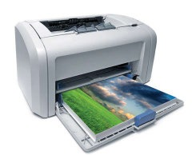
Buffers
Activity 5
fast
slow
Computer
(fast)
Buffer
(temporary memory)
Printer / disc
(slow)
Printer buffer
Why use a buffer?
Examples
Devices send and receive at different speeds
The computer fills the buffer quickly, then carries on with other tasks
The slow device takes data from the buffer at its own rate
Printing a document
Writing to a hard disk or optical disc
Streaming video or music
Keyboard input
11
Notes:
A buffer is an area of memory (usually RAM) used for temporary storage of data while it is transferred between two devices or processes that work at different speeds. The faster device fills the buffer and carries on with other tasks; the slower device takes data from the buffer at its own rate, so it is not overloaded. Examples: printer buffer, writing to a hard disk or optical disc, video / audio streaming (the buffer fills ahead so playback does not stop), keyboard buffer. Worksheet Task 4 now.

Slide 12
Exam focus: explaining a buffer (Paper 1)
Exam focus
9618/13 Oct/Nov 2022 Q1(c)
A computer uses a buffer when playing the audio message. Explain the purpose of a buffer in a computer system using one other example. [3]
 | Official marking points
Purpose (max 2) | To act as temporary storage // to store (downloaded) data ... ... before it is used by the receiving device; ... to allow processes / devices to operate at different speeds // independently of each other
Example (max 1) | Printer buffer when data is transferred from a computer to a printer; video buffer when streaming videos; keyboard buffer when performing data entry
Say what it is (temporary storage), why (different speeds), and give a NEW example.
12
Notes:
9618/13 Oct/Nov 2022 Q1(c): "A computer uses a buffer when playing the audio message. Explain the purpose of a buffer in a computer system using one other example." [3]. Official marking points: purpose max 2, example max 1. Note the example must be a different one from the question (not audio). Then start Task 5.

Slide 13
Guided practice and pacing
Activity 6
Time | Slides | Worksheet
0-5 min | 2 | Task 1 Starter: what do you remember?
5-15 min | 4-6 | Magnetic hard disk; Task 2
15-25 min | 7-8 | Solid state memory, HDD or SSD; Task 3
25-40 min | 9-12 | Optical discs, buffers, exam focus; Task 4
40-45 min | 15 | Exit question
Homework | - | Task 5 Real Paper 1 questions
Check your work against the answer key when your teacher shares it.
13
Notes:
Suggested plan for a shorter lesson (about 45-50 minutes). Task 5 is homework.

Slide 14
Common misconceptions
Plenary
Misconception | Why it is wrong
A hard disk reads data in any order instantly | The platter must rotate to the right sector and the head must move to the right track - this delay is latency
An SSD stores data magnetically | It traps electrons in the floating gate of NAND (or NOR) flash cells; there are no moving parts
Flash memory can overwrite one byte at a time | NAND flash erases whole blocks before writing new data
SSDs are always the better choice | HDDs cost less per GB, come in larger sizes and cope better with very many writes
A laser reads the pits as 1 and the lands as 0 | The CHANGE in reflection between a pit and a land is read; the differences are turned into 1s and 0s
Blu-ray holds more because the disc is bigger | The discs are the same size: the blue laser's shorter wavelength allows smaller pits and closer tracks
A buffer makes the slower device faster | It lets two devices work at different speeds, so the faster one is not kept waiting
14
Notes:
Ask students which they believed at the start.

Slide 15
Exit question
Plenary
On a sticky note or mini-whiteboard:
a
Hard disk
Describe two steps in how a magnetic hard disk reads or writes data. [2]
b
Flash memory
Which gate in a flash memory cell keeps the electrons when the power is off? [1]
c
Buffer
Explain why a computer uses a buffer when printing. [2]
15
Notes:
Model answers:
(a) Spindle spins the platters (1); the arm moves the read/write head to the track (1); writing magnetises areas of the surface / reading detects changes in the magnetic field (1) - any two.
(b) Floating gate (1).
(c) The computer sends data faster than the printer can print, so the data is held temporarily in the buffer (1) and the computer can carry on with other tasks (1).

Slide 16
In this lesson, you
Summary
Described how a magnetic hard disk reads and writes data on tracks and sectors
Described how flash memory traps electrons in a floating gate
Compared hard disks and solid state drives
Described how an optical disc reader/writer uses a laser, pits and lands
Explained why buffers are used
Next: input and output devices, ADC and DAC.
16
Notes:
Next lesson: input and output devices - laser printer, 3D printer, microphone, speakers, touchscreen, virtual reality headset - and why analogue to digital (ADC) and digital to analogue (DAC) converters are needed.

Slide 17
Sources
Credits
Photos: Wikimedia Commons (title - author, licence)
2, Blu-ray, Backside - Kent Madsen (CC BY-SA 2.0)
Blue ray dvd disk - Paolo Neo (Public domain)
Harddisk in USB external box - Vojtěch Brzek (Public domain)
Hard disk drive platter, Samsung MP0402H - Mk2010 (CC BY 4.0)
Actuator arm assembly of a hard disk drive - Mk2010 (CC BY 4.0)
Dell XPS 17 Optical Disc Drive Lens - Tghe-retford (CC BY-SA 3.0)
Atomic Force Microscopy DVD Disks - Anupamakar10 (CC BY-SA 4.0)
HP-C3010-DiskDrive 06 - Thomas Schanz (CC BY-SA 3.0)
SanDisk 128MB SD card - Mister rf (CC BY-SA 4.0)
Samsung 870 QVO 8TB SATA 2,5 Zoll Internes Solid State Drive (SSD) (MZ-77Q8T0BW) 20211008 SSD023 corr - PantheraLeo1359531 (CC BY 4.0)
Kingston Technology DataTraveler G4 USB flash drive USB 3.0 32 Gb - Dmitry Makeev (CC BY-SA 4.0)
Textbook
Watson, D. and Williams, H. Cambridge International AS & A Level Computer Science, Hodder Education, 2019, Chapter 3.1 (text, Table 3.4; 5 photos: RAM, hard disk, SSD, optical disc, laser printer).
Exam questions
Cambridge International AS & A Level Computer Science 9618 question papers and mark schemes: 9618/13 Oct/Nov 2022, 9618/11 June 2023, 9618/11 June 2024, 9618/11 and /13 Oct/Nov 2024, 9618/11 June 2025. (c) Cambridge University Press & Assessment.
17
Notes:
All photographs not from the textbook are from Wikimedia Commons, used under the licence shown. Exam questions are from Cambridge International AS & A Level Computer Science 9618 past papers and mark schemes.

